Slide 1
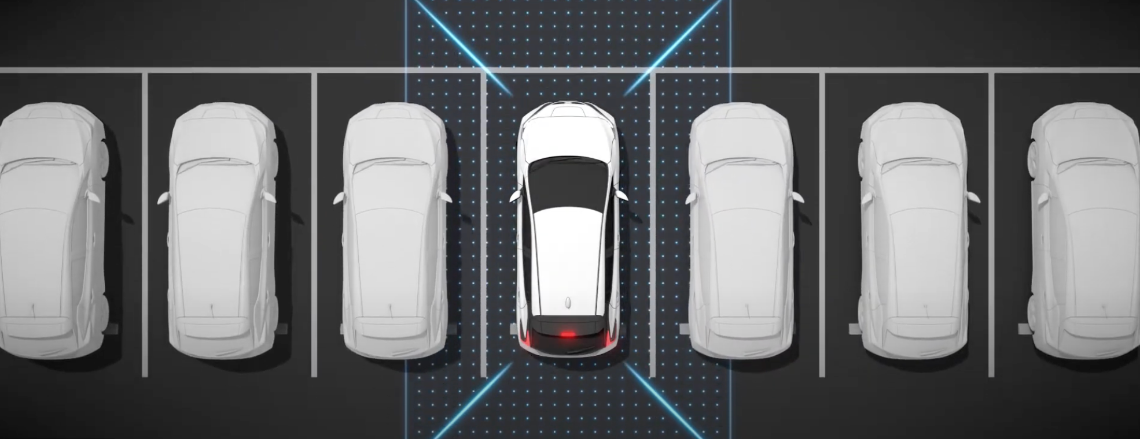
PARKING SPOT
DETECTION
USING YOLOv8 and VGG16
PRESENTATION

Slide 2
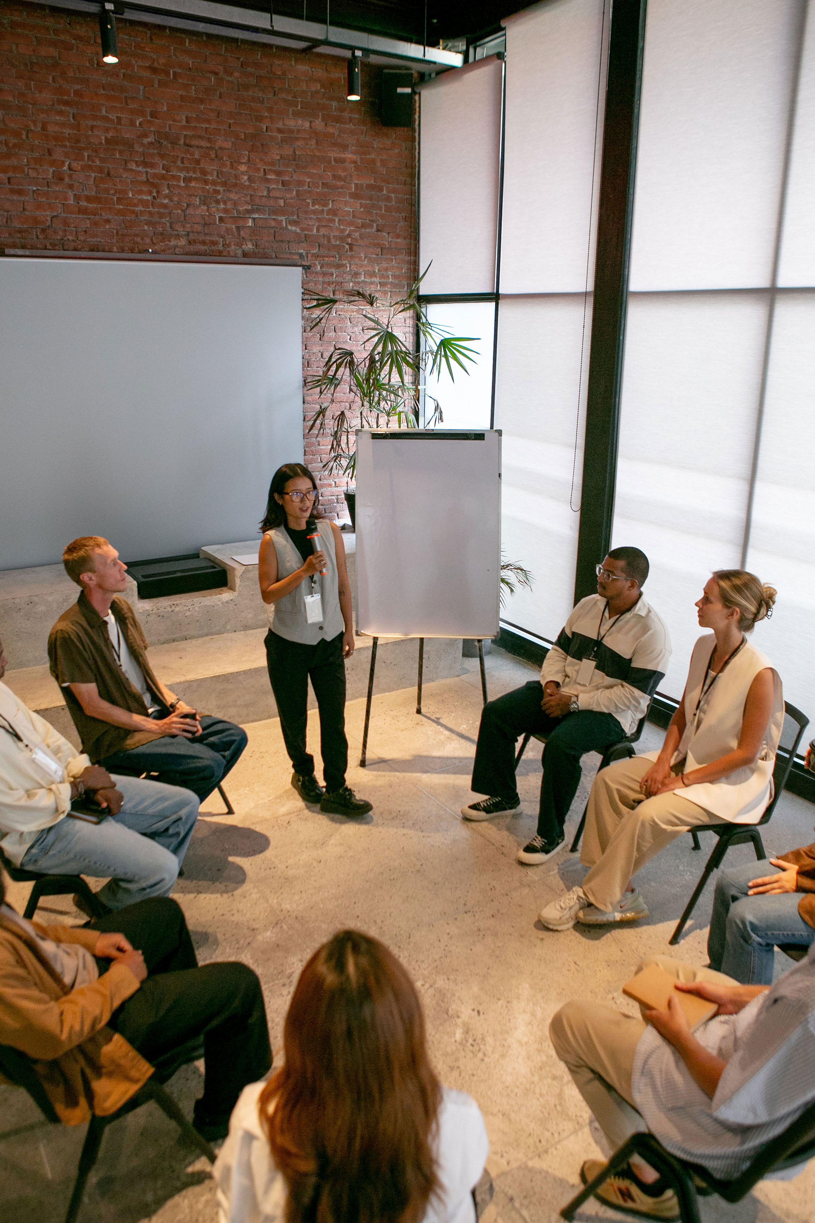
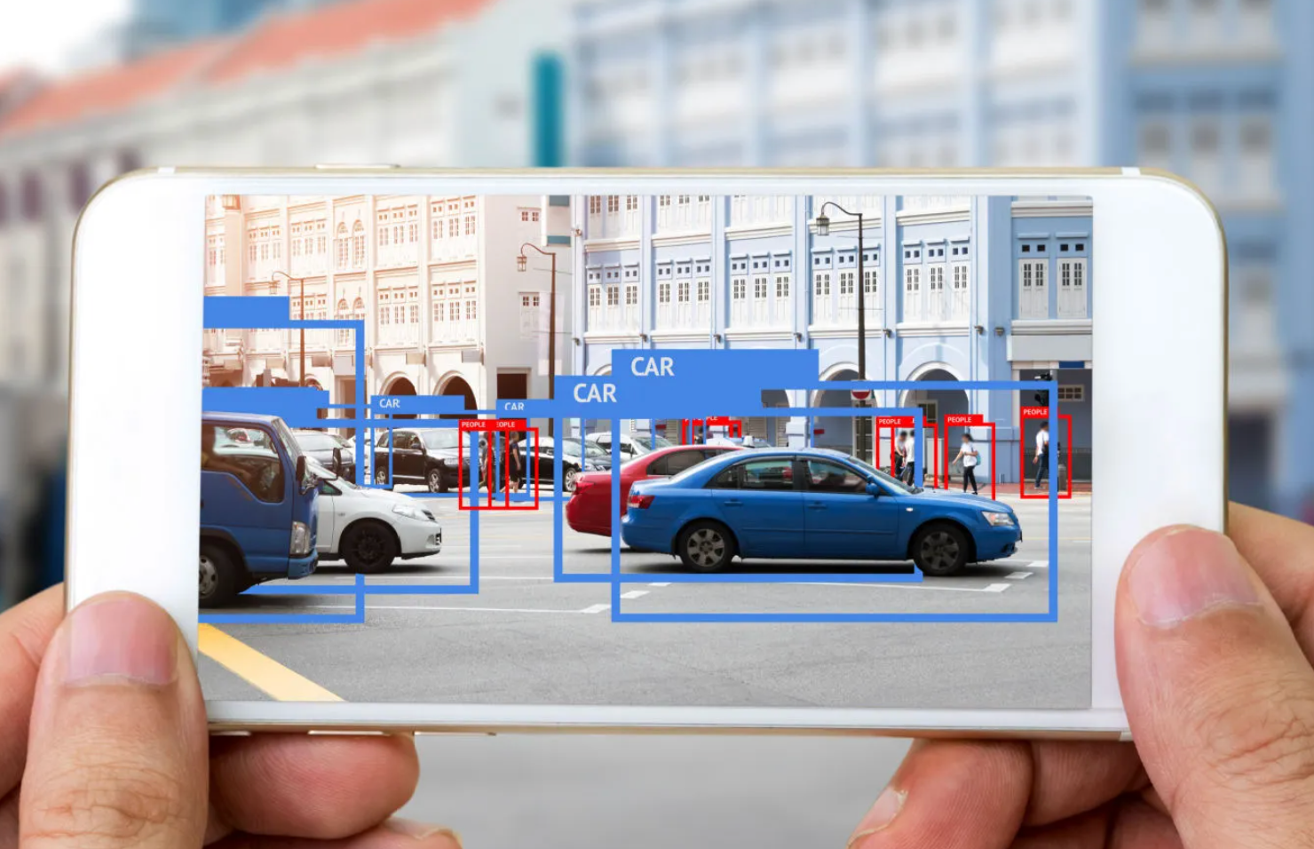
Introduction
Problem Statement
Finding available parking spots efficiently is a widespread urban problem.
Why This Problem
Manual search wastes time, increases emissions, causes congestion
Research Done
Literature on parking systems, computer vision-based parking detection, traditional IoT sensor-based systems.

Slide 3

Overall End-to-End Solution
1
2
3
Scope of Solution
Key Stakeholders
Current Status-Quo
Focused on detecting open parking spots from images using computer vision.
Parking management companies, city planners, drivers.
Manual monitoring
IoT-based sensors (expensive, maintenance issues)

Slide 4









EXECUTION ROADMAP
1
2
3
4
5
Capture Images
Detect Cars (YOLOv8)
+
Cropping
Classify Open/Closed (VGG16)
Predict Open Spots
Display to User

Slide 5













VALUE, COSTS, AND SUCCESS METRICS
Cost-Benefit Tradeoff
Value
Cheaper than IoT sensors, scalable with existing cameras
Faster parking, less traffic, improved experience
Cost-Benefit Tradeoff
Success Metrics
Google Colab GPU, OpenCV, Ultralytics YOLOv8, TensorFlow.
Accuracy > 85%, Speed (processing under 5s/image)

Slide 6
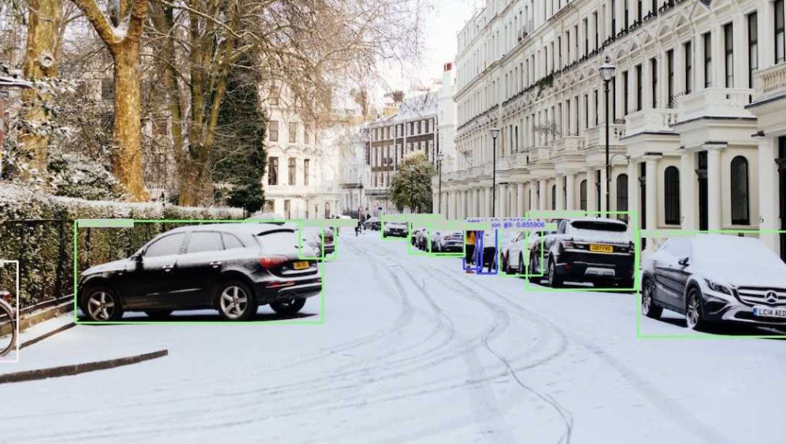
Workflow Updates
Validation and Monitoring
People
People
Pre
deployment
Process
Pre
deployment
Technology

Slide 7
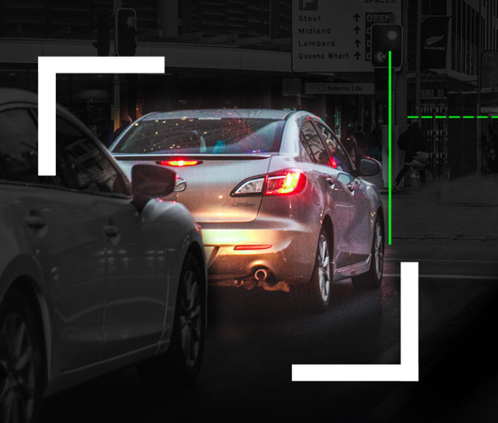
CV Model
Section

Slide 8
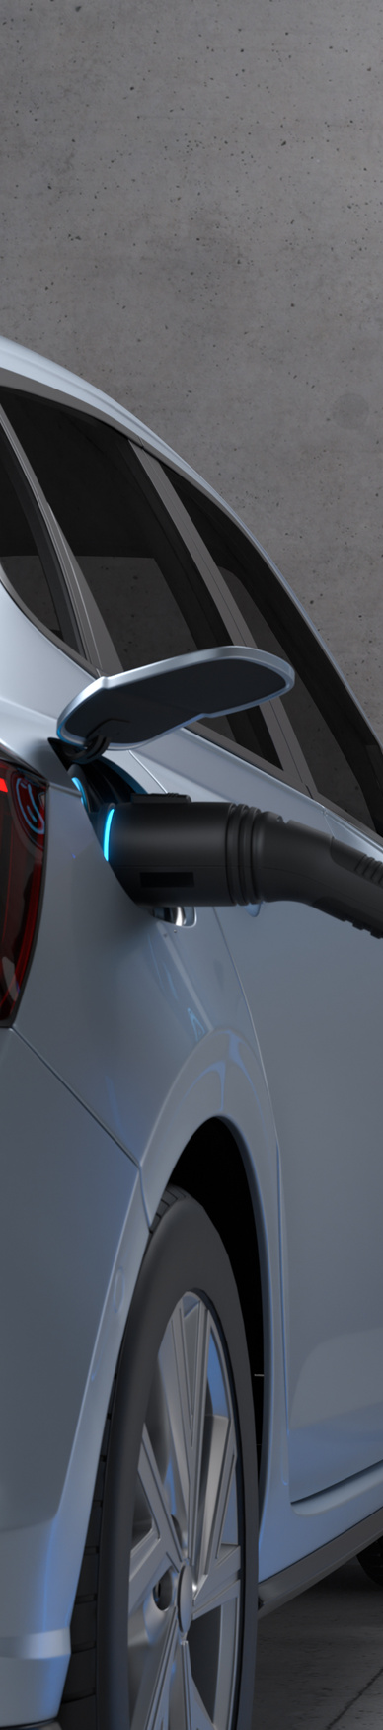


CV MODEL ARCHITECTURE
Object
Detection
CV
Model
Evaluation
Classification
(YOLOv8)
(VGG16)
(Proof-of-Concept)
Purpose: Detect and crop cars from parking lot images.
Pre-trained model used: YOLOv8n (nano version for speed).
Purpose: Classify cropped spots as Open or Closed.
Modified VGG16: Added GAP + Dense Layers.
Training Accuracy: 96%
Validation Accuracy: ~60%
Issues: Overfitting (small dataset).

Slide 9
OUTCOME-ACTION PAIRINGS AND COST ANALYSIS
Outcome | Model Prediction | Real Situation | Action Taken | Cost Impact
TP | Open | Open | Display spot to driver | Positive
TN | Closed | Closed | Hide spot from driver | Positive
FP | Open | Closed | Mislead driver to occupied spot | High (driver frustration, system distrust)
FN | Closed | Open | Hide a usable spot | Medium (opportunity loss)

Slide 10
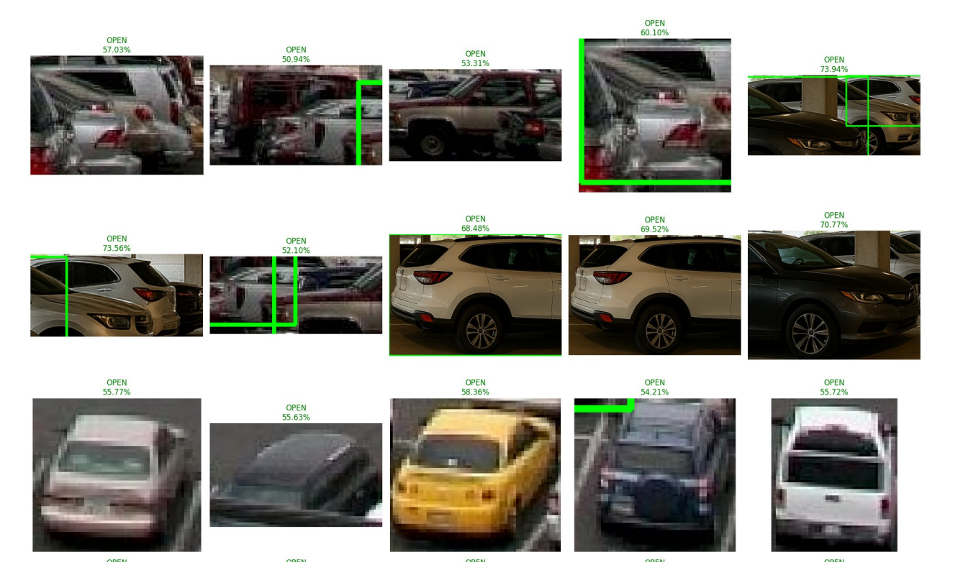
OPEN AND CLOSED IDENTIFICATION
Insights
To minimize False Positives (FP)
Set a higher prediction threshold (e.g., 0.7 instead of 0.5).
Tradeoff
Fewer available spots detected, but more trustworthy.

Slide 11

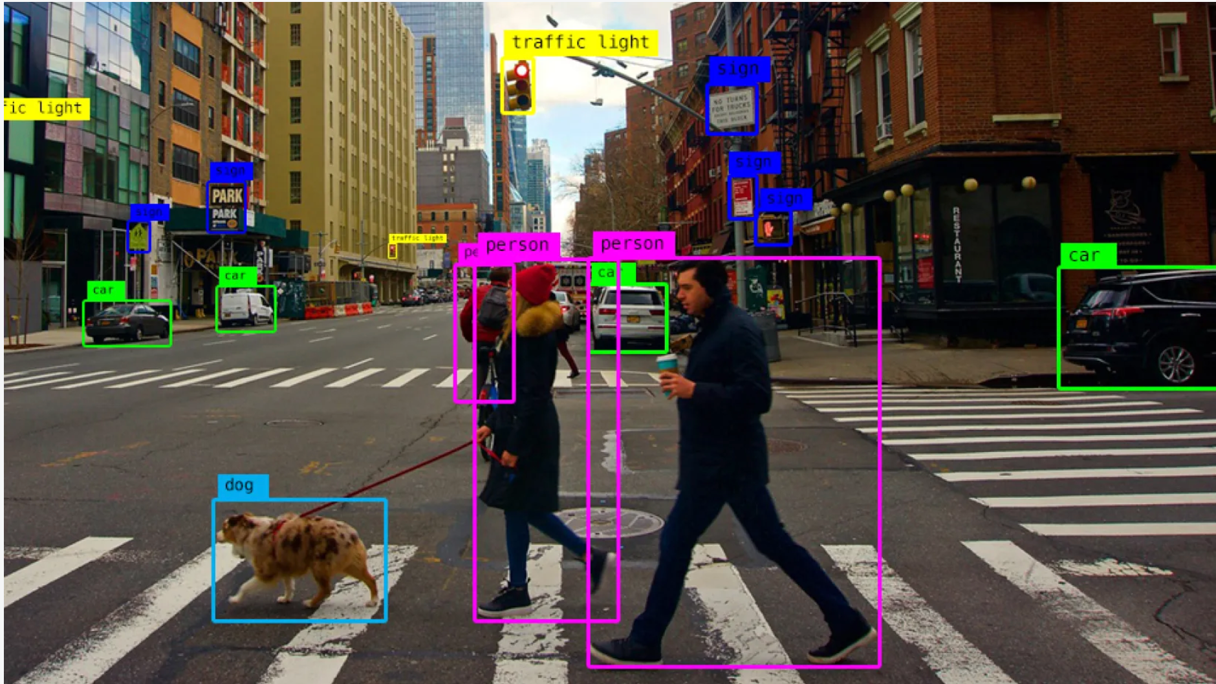
BIASES AND LIMITATIONS
1
Unintended Consequences
2
Privacy/Security
3
Bias
4
Augment dataset with
more diverse samples.

Slide 12











SCALING POTENTIAL
Expansion into Different Domains
Scaling to Different Camera Types
Scaling Across Larger Parking Lots
Scaling Across Cities
Integrating with Smart Parking Apps

Slide 13
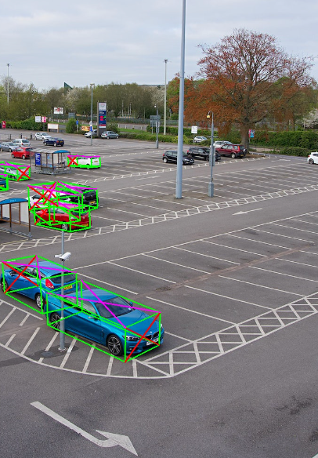

TARGET SEGMENT
Deploy to large parking lots
Integrate into smart apps
Scaling Potential
Use different camera feeds
Expand to new cities
Small datasets = Overfitting risk
Lessons Learned
Need diverse data (lighting, weather)
Open-source models need tuning
Think about deployment early

Slide 14
SUMMARY
Team Member | Tasks Performed
Anwesha Banerjee | Content for PPT and Insights from data
Sagar Prasad | Code-Detection & Cropping
Ryan Karim | Proposal
Kevin M | Code-Classification
Zifan Wang | Dataset Research

Slide 15
REFERENCES
YOLOv8: Ultralytics
VGG16: Keras Applications
TensorFlow documentation
Githubs Links of dataset

Slide 16
THANK YOU

